Slide 1
Composite Beam Bending
ASEN 2001 Lab 3 Session 3
Fall 2018

Slide 2
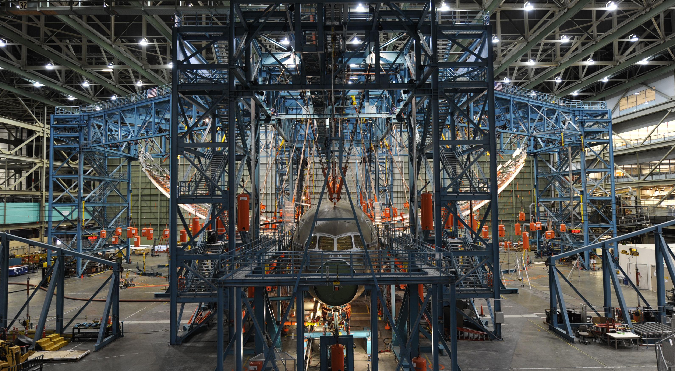
Boeing 787 – Bending Test

Slide 3
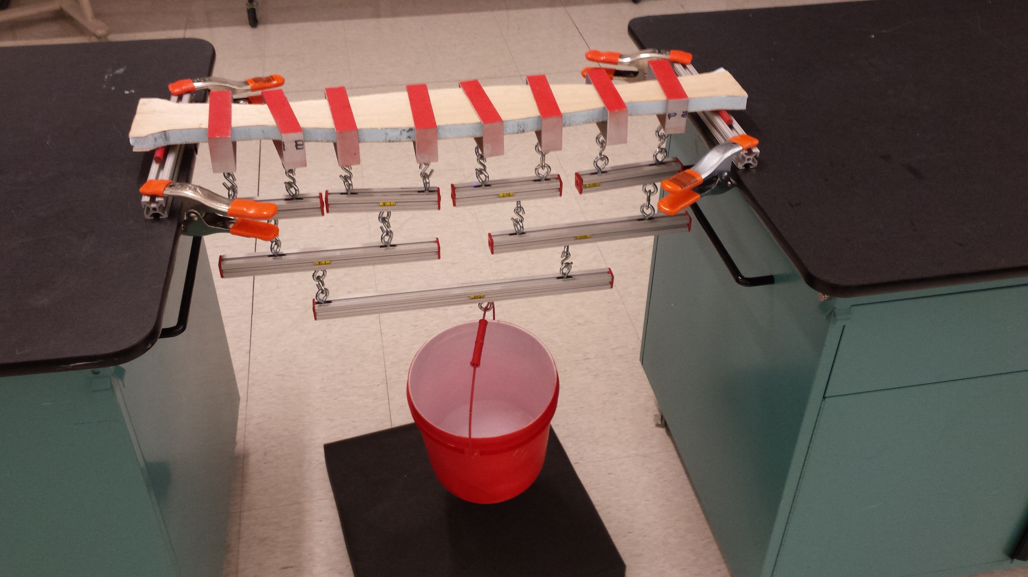
Lab 3 – Wiffle tree test setup
bars
wing
metal straps
clamp
sliding hooks
bucket for weights
entire wiffle tree

Slide 4
To do list – Nov 26th
Finish designing the optimal wing plan form
Design wiffle tree strap locations
width

Slide 5
Wiffle tree design
Aerodynamic loading
Objective:
Simulate the aerodynamic loading by concentrated loads.
Wiffle tree
How?
Find the loop and hook locations such that shear and bending diagrams of wiffle tree loading is as close as possible to those of aerodynamic loading.

Slide 6
Wiffle tree design
Objective:
Simulate the aerodynamic loading by concentrated loads.
Aerodynamic loading
How?
Find the loop locations such that shear and bending diagrams of wiffle tree loading is as close as possible to those of aerodynamic loading.
Wiffle tree

Slide 7
Schematic of wiffle tree
?
Wiffle tree
?
?
Wiffle tree
Aerodynamic loading

Slide 8
Wiffle design – Centroid approach
L/8
L/8
L/8
L/8
C₁
C₂
C₃
C₄
F

Slide 9
Wiffle design – Strap locations
O
Bar
Moment equilibrium of bar:
Note: In your calculations also account for the weight of bars, straps, and hooks.

Slide 10
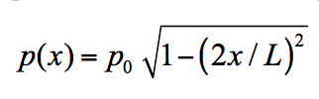
Some common questions
Coordinate system in which geometry/loading is defined?
= 36”
x = -L/2
x = 0
x = +L/2

Slide 11
Some common questions
Loading direction?
= 36”
The direction does not matter as cross section is symmetric with
respect to neutral axis. In the wiffle tree test, we apply load downward for convenience in order to hang weights.
Neutral axis

